Slide 1
Knox County, TN
Debt Capacity Analysis
February 19, 2019
PFM Financial Advisors LLC
530 Oak Court Drive
Suite 160
Memphis, TN 38117
(901) 682-8356
pfm.com

Slide 2
Overview
PFM evaluated the County’s debt capacity by considering its existing resources, mainly the General Fund and Debt Service Fund balances.
The two major factors to consider when analyzing debt capacity are: affordability and credit capacity.

Slide 3
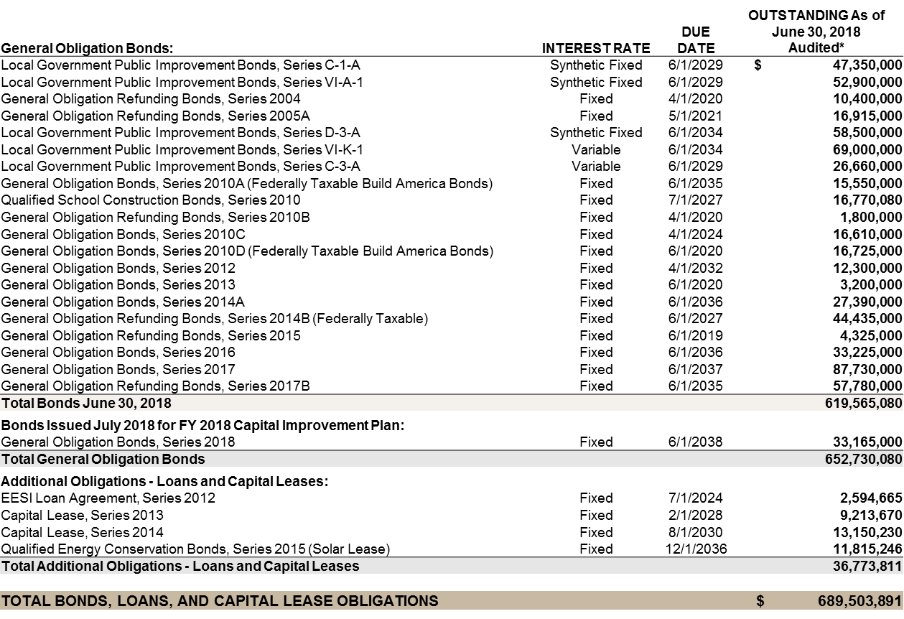
Debt Overview

Slide 4
Existing Bonded Debt
Based on the current debt structure, the County will retire approximately 59% of its debt within the next 10 years.

Slide 5
Debt Overview – Refunding Opportunities
Recent tax reform eliminated the ability to refinance debt before the call date and maintain the tax-exempt interest rates.
Build America Bonds (BABs) can be refunded before the call date with tax-exempt interest rates.
Refunding Opportunities based on current market rates as of February 12, 2019.

Slide 6
Proposed Debt
PFM used the following assumptions when structuring proposed debt issuances:
  Level debt service
  20 year amortization
  Interest rate of 5%
  Amounts are based on the FY 2019 adopted Capital Improvement Plan
 | FY 2019 | FY 2020 | FY 2021 | FY 2022 | FY 2023
County Projects | 23,015,000 | 22,615,000 | 20,795,000 | 20,615,000 | 20,100,000
School Projects | 12,400,000 | 7,400,000 | 10,000,000 | 10,000,000 | 10,000,000
Total | 35,415,000 | 30,015,000 | 30,795,000 | 30,615,000 | 30,100,000

Slide 7
Existing & Proposed Debt Service

Slide 8
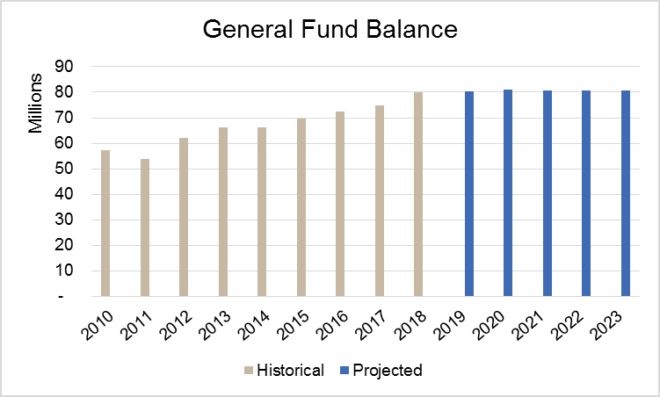
Existing Resources – General Fund Affordability
PFM evaluated the feasibility of using resources from the County’s General Fund by projecting revenues and expenditures based on the growth rates shown here.
 | General Fund Revenues | Growth Rates
 | Property Taxes | 1.5%
 | Local Option Sales Tax | 2.0%
 | All Other Revenues | 1.0%
 | General Fund Expenditures | Growth Rates
 | Other Financing Uses | 4 year Average
 | All Other Expenses | 2.0%
Based on this analysis and expectation to maintain the current fund balance level going forward, the General Fund is limited in its ability to support new General Obligation Debt.

Slide 9
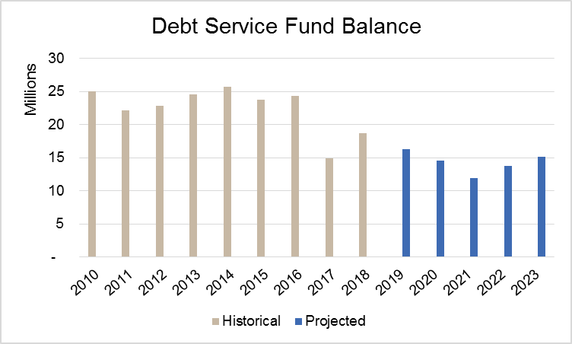
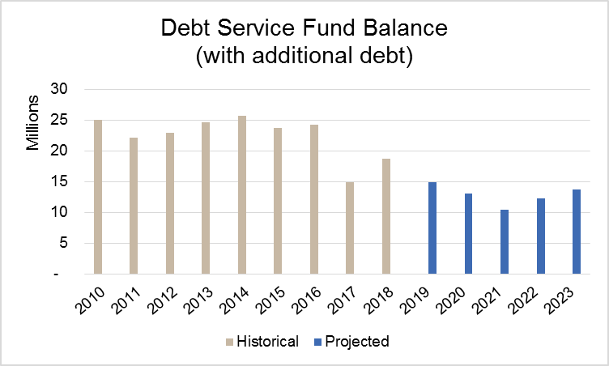
Existing Resources – Debt Service Fund Affordability
For the Debt Service Fund, property taxes and other local revenues were projected to grow at 1.0-1.5% and expected debt service costs were used.
Proposed bond issuances in FY 2019 – 2023 were included, with similar bond issue estimates for FY 2024 – 2030.
PFM estimated that approximately $1.500M of projected fund balance could be leveraged to support an additional $18.645M of general obligation debt.

Slide 10
Credit Capacity* (Moody’s at Aa1 and S&P at AA+)
Using PFM’s Credit Calculator and rating methodologies (Moody’s and S&P), PFM estimated how much additional debt could be issued and how much fund balance can be used before negatively impacting the County’s credit rating
  The Credit Calculator does not take into consideration affordability, nor any budgetary changes, like additional revenues sources (i.e. property tax increase), that would be necessary in order to support the additional debt service costs.
From a credit perspective, issuing the additional debt as part of the FY 2019 Capital Improvement Plan, would not negatively impact the County’s credit rating.
The County has a General Fund Unassigned Fund Balance policy to maintain 25% of expenditures/transfers. Any use of Unassigned Fund Balance should be limited for one-time, non-reoccurring expenditures to avoid credit concerns.
*Note: Credit capacity estimates are based on quantitative metrics only and do not include qualitative metrics or below the line adjustments made by rating agencies

Slide 11
Thank You

