Slide 1
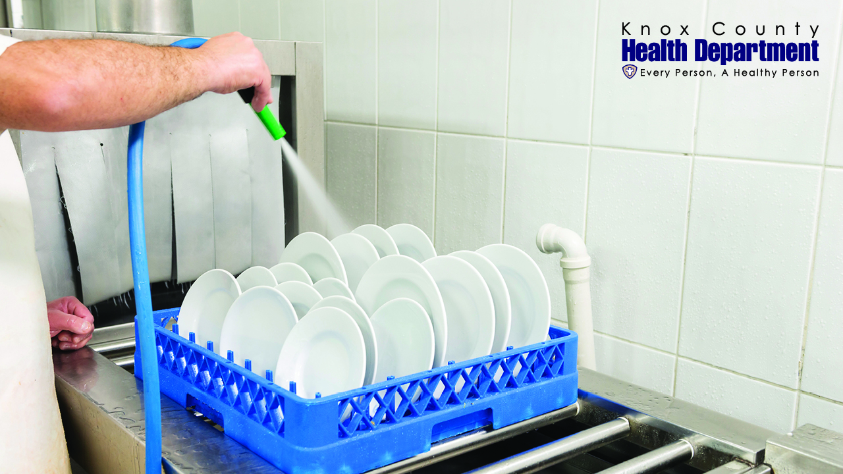
Food Safety Training Preventing Foodborne Illness
Knox County Health Department
Environmental Health
140 Dameron Ave.
Knoxville, TN 37917
865-215-5200

Slide 2
Welcome to the Knox County Health Department Food Safety Training!
Our goal is that by the end of this training, you will:
Recognize the importance of preventing foodborne illness, and
Understand how you can prevent foodborne illness.

Slide 3
About This Training
This training will include sections on:
Foodborne Illness
The 5 Major Foodborne Illness Risk Factors:
1. Improper Holding & Cooling
2. Inadequate Cooking
Contaminated Food, Utensils, and Equipment
Poor Employee Health & Hygiene
Food From Unsafe Sources
Additional Prevention Measures from the TN Food Service Establishment Rules:
Consumer Advisory
Date Marking
Specialized Processing
Manager Certification

Slide 4
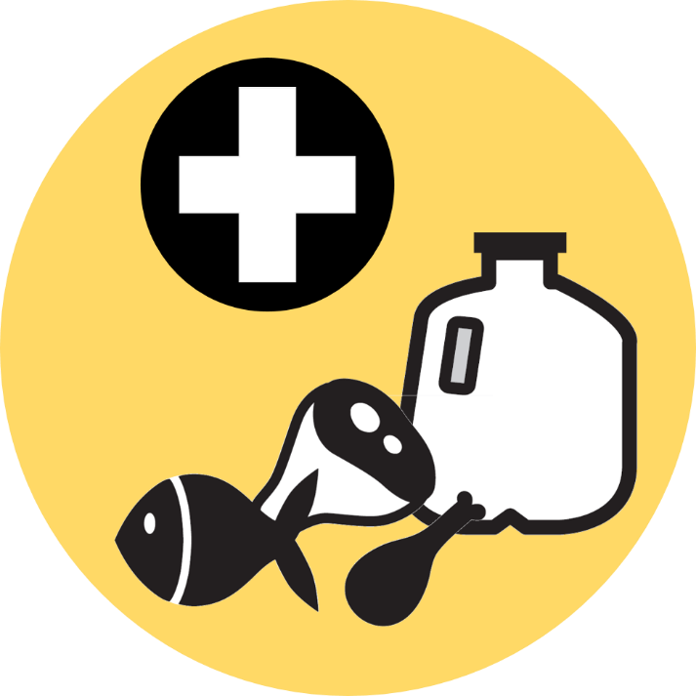
Foodborne Illness

Slide 5
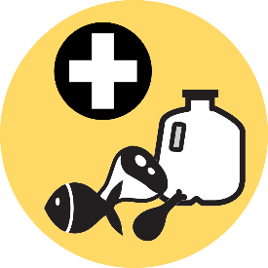
What is foodborne illness?
Foodborne Illness
Foodborne illness has many names, including:
Food poisoning
Foodborne disease
Foodborne infection

Slide 6
Who can be affected by foodborne illness? (click an option below)
Test Your Knowledge
older adults
pregnant women
children
healthy adults
restaurant employees

Slide 7
Who can be affected by foodborne illness? (click an option below)
Test Your Knowledge
everyone is at risk for foodborne illness

Slide 8
What are the symptoms of foodborne illness?
Foodborne Illness
There are many symptoms of foodborne illness, including:
Chills
Nausea
Vomiting
Diarrhea
Abdominal cramps
Jaundice
Fever
Dizziness

Slide 9
What causes foodborne illness?
Foodborne Illness
Bacteria,
Viruses,
Parasites,
Molds,
Toxins (including chemical toxins, like pesticides), and
Allergens

Slide 10
How many people does foodborne illness affect?
Foodborne Illness
Every year in the U.S., foodborne illness:
Sickens 1 in 6 people (a total of 48 million people)
Hospitalizes 128,000 people
Kills 3,000 people
Foodborne illness also costs the U.S. an estimated $152 billion every year

Slide 11
How are restaurants related to foodborne illness?
Foodborne Illness
In 2013, food prepared in restaurants was related to:
60% of foodborne illness outbreaks and
51% of outbreak-associated illness

Slide 12
How are restaurants related to foodborne illness?
Foodborne Illness
In Tennessee, restaurants were related to:
Nearly 56% of foodborne illness outbreaks, and
25% of hospitalizations related to foodborne illness

Slide 13
How can foodborne illness be prevented?
Foodborne Illness
Safe food handling practices!
(Also known as “food safety”.)
Food safety aims to prevent illness, and protect the health and safety of those eating AND working with food.

Slide 14
How can foodborne illness be prevented?
Foodborne Illness
Chance of foodborne illness is lowered by:
Safe food handling practices
Proper cooking and storage
Adequate cleaning and sanitation
All of which you will learn about today!

Slide 15
What is the Health Department’s role in preventing foodborne illness?
Foodborne Illness
Environmental Health Specialists (aka, Health Inspectors) with the Knox County Health Department (KCHD) help establishments prevent foodborne illness by:
Serving as a resource for questions and food safety education, and
Conducting inspections to ensure establishments understand proper food safety procedures that will help prevent foodborne illness.

Slide 16
How do Health Inspectors determine proper food safety procedures?
Foodborne Illness
The current regulations in Tennessee for food safety are the TN Food Service Establishment Rules. This is what:
KCHD inspections are based on, and
What this training is based on

Slide 17
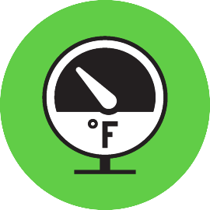
5 Major Risk Factors for Foodborne Illness

Slide 18
The 5 Major Risk Factors for Foodborne Illness are:
1. Improper Holding & Cooling
2. Inadequate Cooking
Contaminated Food, Utensils, and Equipment
Poor Employee Health & Hygiene
Food From Unsafe Sources

Slide 19
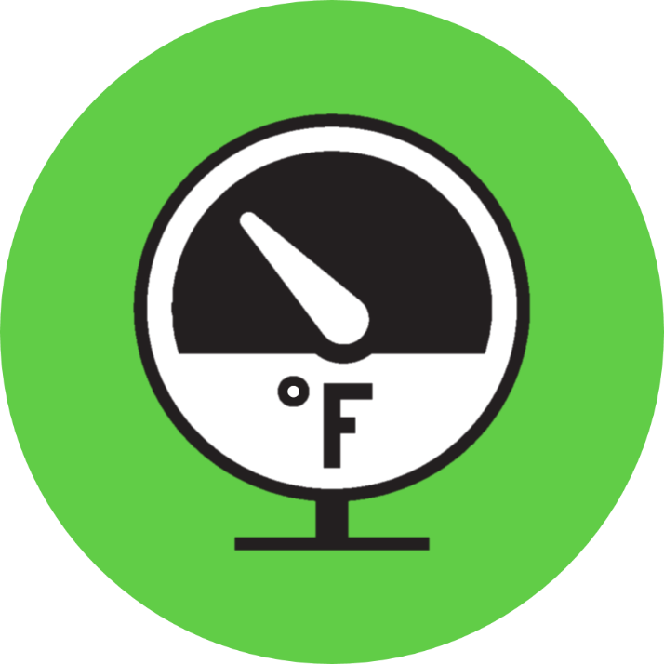
Risk Factor 1: Improper Holding & Cooling

Slide 20
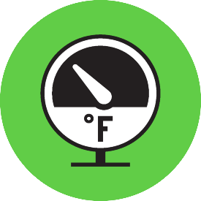
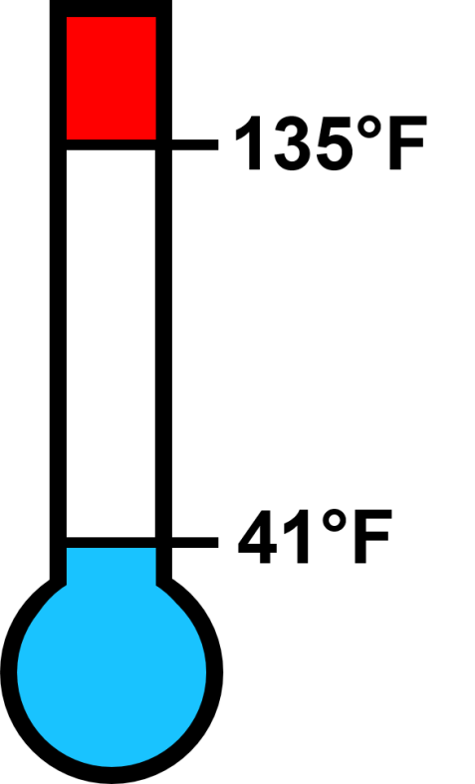
Why are holding and cooling procedures important?
Risk Factor 1: Improper Holding & Cooling
Bacteria that cause foodborne illness grow rapidly in foods when they are between 41°F and 135°F.
!
This temperature range is called the temperature danger zone.

Slide 21
Why are holding and cooling procedures important?
Risk Factor 1: Improper Holding & Cooling
Proper heating and cooling procedures reduce the time a food is in the temperature danger zone (between 41°F and 135°F.)
This prevents growth of bacteria, preventing foodborne illness.
!

Slide 22
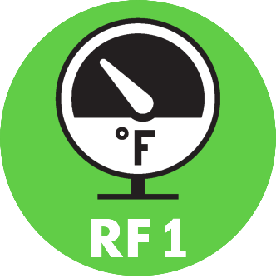
Time/Temperature Control for Safety (TCS) Foods
Risk Factor 1: Improper Holding & Cooling
Certain foods have conditions that are ideal for the growth of bacteria that cause foodborne illness
These foods are called Time/Temperature Control for Safety Foods, or TCS Foods

Slide 23
Time/Temperature Control for Safety (TCS) Foods
Risk Factor 1: Improper Holding & Cooling
TCS foods include:
Meat, fish, poultry, seafood
Eggs and dairy products
Cooked vegetables
Tofu
Cooked rice, beans, pasta and potatoes
Sprouts (alfalfa and bean)
Cut melons
Garlic or herbs bottled in oil
Sliced tomatoes
Cut leafy greens

Slide 24
Proper Holding & Cooling
Risk Factor 1: Improper Holding & Cooling
To keep TCS Foods safe and out of the temperature danger zone, proper procedures should be followed for:
Cooling food
Holding hot food (soups, cooked rice, etc.)
Holding cold food (cut fruit, tuna salad, etc.)

Slide 25
Cooling Food
Risk Factor 1: Improper Holding & Cooling
135°F
TCS Foods must be cooled from 135°F to 41°F or below within six hours
6
hours
41°F

Slide 26
There are two important cooling stages:
Risk Factor 1: Improper Holding & Cooling
135°F
2
STAGE 1: Reduce the temperature from 135°F to 70°F or below within two hours
hours
70°F
41°F

Slide 27
There are two important cooling stages:
Risk Factor 1: Improper Holding & Cooling
135°F
2
STAGE 1: Reduce the temperature from 135°F to 70°F or below within two hours.
STAGE 2: Reduce the temperature from 70°F to 41°F or below within the next four hours.
hours
70°F
4
41°F
hours
Note: Foods prepared from ambient temperatures must be cooled to below 41°F or below within four hours of preparation.

Slide 28
How can you be sure foods are cooled properly?
Risk Factor 1: Improper Holding & Cooling
135°F
Check the temperature of the food with a calibrated thermometer during the two cooling stages to make sure:
After two hours of cooling from 135°F or above, the food will reach 70° F, and
2
hours
70°F
41°F

Slide 29
Risk Factor 1: Improper Holding & Cooling
How can you be sure foods are cooled properly?
135°F
Check the temperature of the food with a calibrated thermometer during the two cooling stages to make sure:
After two hours of cooling from 135°F or above, the food will reach 70° F, and
After six total hours of cooling from 135°F or above, the food will reach 41° F or below.
Note: Temperature logs are recommended
6
hours
41°F

Slide 30
Why use a calibrated thermometer?
Risk Factor 1: Improper Holding & Cooling
Calibrating a thermometer makes sure it is reading temperatures correctly.
Correct temperatures are key for making sure food remains safe when:
Cooking,
Storing,
Cooling, and
Holding

Slide 31
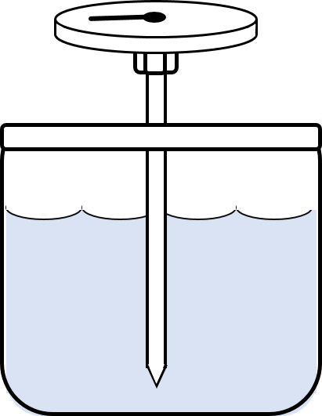
How should you calibrate a thermometer?
Risk Factor 1: Improper Holding & Cooling
There are two ways to calibrate a thermometer:
With Ice water:
Fill a container with ice, then add water until the container is full.
Completely submerge the sensing area of the thermometer for 30 seconds.
The thermometer should read 32° F. If it doesn’t, adjust the thermometer until it reads 32° F.
32° F

Slide 32
How should you calibrate a thermometer?
Risk Factor 1: Improper Holding & Cooling
With boiling water
Boil clean tap water in a large pot.
Completely submerge the sensing area of the thermometer for 30 seconds.
The thermometer should read 212° F. If it doesn’t, adjust the thermometer until it reads 212° F.
212° F

Slide 33
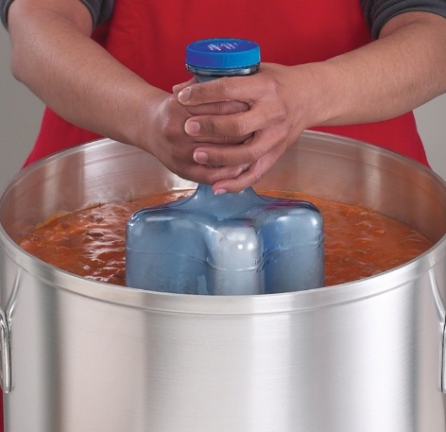
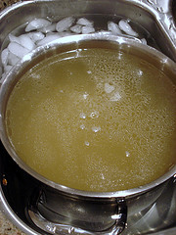
There are several ways you can help foods cool faster:
Risk Factor 1: Improper Holding & Cooling
Use shallow containers to reduce the volume
Change the type of container (metal containers cool faster than plastic)
Make smaller portions (put into several smaller containers or cut large portions of meat into smaller pieces)
Put containers in ice baths
Put ice wands in the container
Add ice as an ingredient
ice wand
ice bath

Slide 34
Holding Hot & Cold Food
Risk Factor 1: Improper Holding & Cooling
When holding TCS food, you can keep food safe by either using:
Temperature (outside of the temperature danger zone), or
Time (held no more than four hours, then thrown out)
This prevents the growth of bacteria that cause foodborne illness.

Slide 35
Using Time Instead of Temperature
Risk Factor 1: Improper Holding & Cooling
This is called using “time as a public health control”
To use time to keep food safe:
Written procedures stating the foods using time must be prepared in advance
Food must be marked to indicate the time that it is taken out of temperature control
Food not served within four hours* must be DISCARDED
*If initial food temperature is at or below 41° F and does not exceed 70° F during holding, the food may be held for six hours before being discarded.

Slide 36
Using Proper Temperatures to Keep Food Safe
Risk Factor 1: Improper Holding & Cooling
When using temperature to keep food safe, foods must stay out of the:
!
Temperature Danger Zone
(41°F to 135°F)

Slide 37
Using Proper Temperatures to Keep Food Safe
Risk Factor 1: Improper Holding & Cooling
To keep hot foods safe, they must stay:
HOT at 135°F or above*
*Unless using time instead of temperature
!

Slide 38
Using Proper Temperatures to Keep Food Safe
Risk Factor 1: Improper Holding & Cooling
To keep cold foods safe, they must stay:
COLD at 41°F or below*
*Unless using time instead of temperature
!

Slide 39
5 Major Foodborne Illness Risk Factors:

1. Improper Holding & Cooling
2. Inadequate Cooking
Contaminated Food, Utensils and Equipment
Poor Employee Health and Hygiene
Food from Unsafe Sources

Slide 40
Risk Factor 2: Inadequate Cooking

Slide 41
Why is adequate cooking important?
Risk Factor 2: Inadequate Cooking
Cooking is the only food preparation step that can actually kill bacteria.

Slide 42
What is “adequate” cooking?
Risk Factor 2: Inadequate Cooking
Adequate cooking means cooking a food to its correct temperature for at least 15 seconds.
This makes sure the foodborne illness-causing bacteria in the food are killed.

Slide 43
What is “adequate” cooking?
Risk Factor 2: Inadequate Cooking
Different foods contain different types of bacteria, which are killed at different temperatures.
This means that different foods have different minimum cooking temperatures to make sure their bacteria are killed.

Slide 44
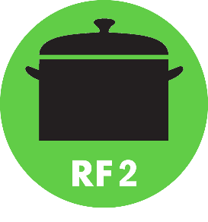
Foods that Must be Cooked to 165°F
Risk Factor 2: Inadequate Cooking
The foods that must be cooked to 165°F for 15 at least seconds are:
Poultry
Stuffed foods or stuffing
Raw animal foods cooked in a microwave
Reheated Time/Temperature Control for Safety Food (TCS) for hot holding

Slide 45
Foods that Must be Cooked to 155°F
Risk Factor 2: Inadequate Cooking
The foods that must be cooked to 155°F for 15 at least seconds are:
Hamburger
Sausage
Injected meats
Eggs (for hot holding)

Slide 46
Foods that Must be Cooked to 145°F
Risk Factor 2: Inadequate Cooking
The foods that must be cooked to 145°F for 15 at least seconds are:
Pork
Eggs (for immediate service)
Fish
Shrimp
Whole intact meats

Slide 47
What is “adequate” cooking?
Risk Factor 2: Inadequate Cooking
Remember, the correct cooking temperature depends on the type of food.
For all foods, be sure to always use a calibrated thermometer to verify temperatures.
Note: Temperature logs are recommended

Slide 48
5 Major Foodborne Illness Risk Factors:

1. Improper Holding & Cooling

2. Inadequate Cooking
Contaminated Food, Utensils and Equipment
Poor Employee Health and Hygiene
Food from Unsafe Sources

Slide 49
Risk Factor 3: Contaminated Food, Utensils and Equipment

Slide 50
What is contamination?
Risk Factor 3: Contaminated Food, Utensils and Equipment
Food can become contaminated when it comes into contact with dirty or contaminated food contact surfaces, or another contaminated food.
This is also called cross-contamination.
It is important to prevent contamination because it
can lead to foodborne illness.

Slide 51
What are the food contact surfaces that can transfer contaminants to food?
Risk Factor 3: Contaminated Food, Utensils and Equipment
Anything that is contaminated and may later come into contact with food can be a source of cross-contamination, including:
Hands and gloves
Knives and cutting boards
Storage and serving containers
Improperly washed/sanitized surfaces, utensils, and equipment

Slide 52
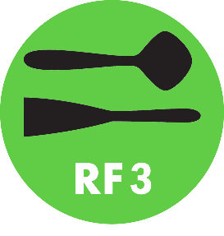
How can you prevent cross contamination?
Risk Factor 3: Contaminated Food, Utensils and Equipment
There are several ways you can prevent cross contamination, including:
Washing hands after handling raw meat, fish, or poultry
Preparing raw meat and poultry in an area away from other foods
Using a separate cutting board for raw meat and poultry
Thoroughly washing, rinsing, and sanitizing ALL food contact surfaces that touch raw meat and poultry

Slide 53
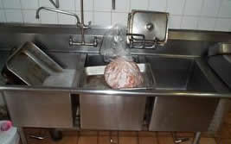
Would this prevent cross contamination?
Test Your Knowledge
No.
Raw meat can contain bacteria that causes foodborne illness.
Leaving raw meat in an area where dishes are cleaned could result in bacteria being transferred to clean dishes, and ultimately lead to foodborne illness.
(Raw meat being thawed in a ware washing sink while dishes are being washed.)

Slide 54
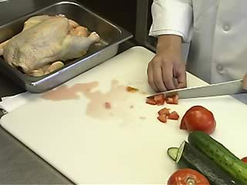
Would this prevent cross contamination?
Test Your Knowledge
No.
Raw chicken can contain bacteria that causes foodborne illness.
The chicken can transfer this bacteria to the cutting board and knife, which can then transfer it to the vegetables.
(Cutting board and knife being used at the same time for raw chicken and vegetables to be served raw.)

Slide 55
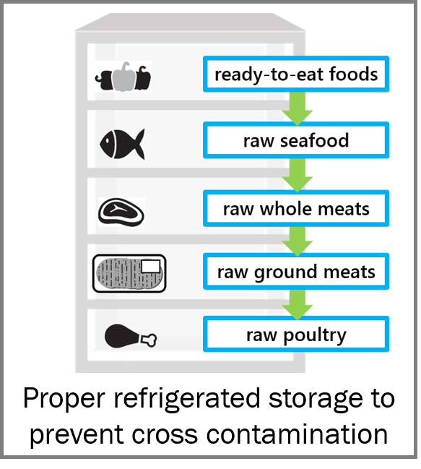
Can cross-contamination occur while food is stored?
Risk Factor 3: Contaminated Food, Utensils and Equipment
Contamination can occur if pieces or juices from raw meat or poultry fall into other foods when stored.
To prevent this, always:
Store raw meat below other foods in the refrigerator, and
Store foods with lower cooking temperatures above foods with higher cooking temperatures

Slide 56
Would this prevent cross contamination?
Test Your Knowledge
No.
Juices or small parts of the meat could drop onto the vegetables, transferring bacteria that may cause foodborne illness.
Since the vegetables may not be cooked to a temperature high enough to kill the bacteria in raw meat, or could even be served raw, this could cause foodborne illness.
(Raw meat stored over vegetables)

Slide 57
How can you prevent contamination?
Risk Factor 3: Contaminated Food, Utensils and Equipment
Washing, rinsing, and sanitizing is key to prevent contamination.
prevent foodborne illness
wash
rinse
sanitize
1
2
3

Slide 58
How can you prevent contamination?
Risk Factor 3: Contaminated Food, Utensils and Equipment
Always wash, rinse, and sanitize utensils and equipment:
Between uses for raw and ready-to-eat foods,
When dirty or contaminated, and
At least every four hours if used continuously at room temperature.
prevent foodborne illness
wash
rinse
sanitize
1
2
3

Slide 59
What is proper sanitizing?
Risk Factor 3: Contaminated Food, Utensils and Equipment
There are two methods of sanitizing that can be used to effectively sanitize utensils and equipment:
Hot water
Chemical
Chlorine or quaternary ammonia solution can be used for chemical sanitizing

Slide 60
How can hot water be used to sanitize?
Risk Factor 3: Contaminated Food, Utensils and Equipment
When using hot water sanitizing for manual washing and sanitizing:
Water must be at least 171°F for at least 30 seconds, and
Dishes must reach 160°F by immersion in the 171°F water.
When using a machine for washing and sanitizing, water must reach:
165°F for a stationary rack, single temperature machine
180°F for all other machines

Slide 61
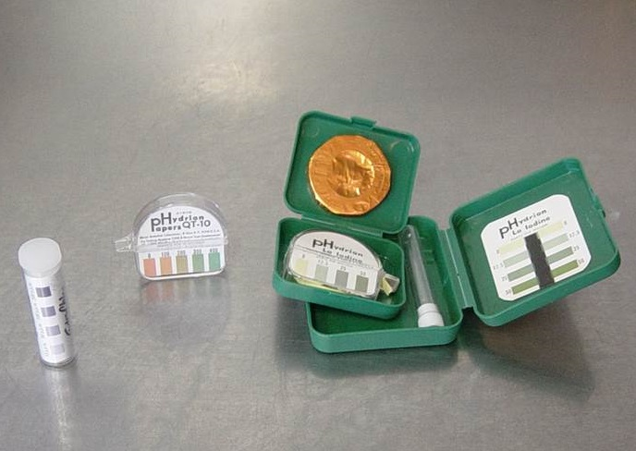
Chemical Sanitizing
Risk Factor 3: Contaminated Food, Utensils and Equipment
For both types of chemical sanitizing, dishes and utensils are immersed in the chemical solution for a specific amount of time.
For chlorine solution:
25-100 ppm immersion for at least 10 seconds
For quaternary ammonia solution:
150-400 ppm immersion for at least 30 seconds
Note: Always follow manufacturer instructions when using sanitizing chemicals.

Slide 62
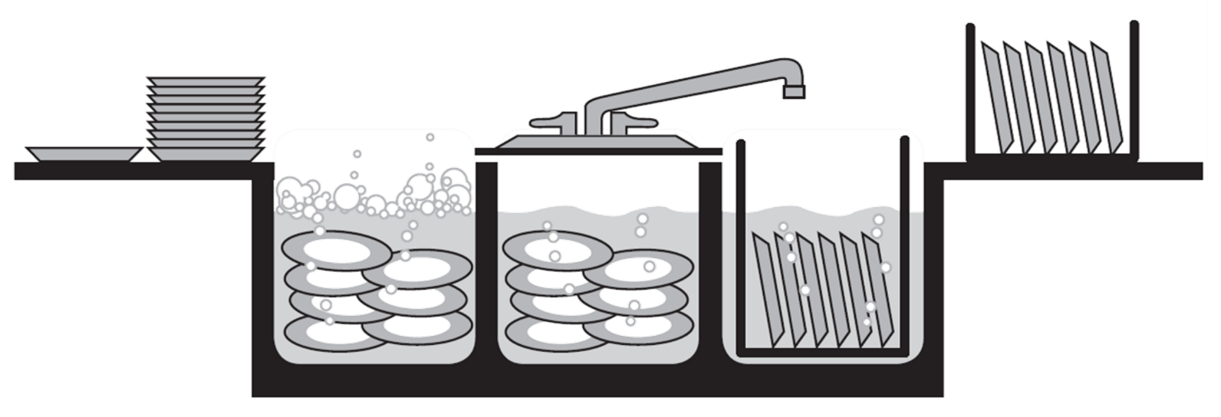
After Sanitizing - Drying
Risk Factor 3: Contaminated Food, Utensils and Equipment
Bacteria that cause foodborne illness can grow in water that is trapped between cleaned and sanitized dishes and utensils.
After dishes and utensils are washed, rinsed, and sanitized, make sure they are left to dry in a way that allows air to circulate.

Slide 63
5 Major Foodborne Illness Risk Factors:

1. Improper Holding & Cooling

2. Inadequate Cooking

Contaminated Food, Utensils and Equipment
Poor Employee Health and Hygiene
Food from Unsafe Sources

Slide 64
Risk Factor 4: Poor Employee Health & Hygiene

Slide 65
Employee Health & Hygiene
Risk Factor 4: Poor Employee Health & Hygiene
Food workers, even if they look and feel healthy, can spread viruses and bacteria
Only food workers who are healthy and practice good personal hygiene keep harmful germs from getting on food, which prevents foodborne illness

Slide 66
Employee Health & Hygiene
Risk Factor 4: Poor Employee Health & Hygiene
Good health and hygiene practices include:
Proper handwashing practices
No bare-hand contact with ready-to-eat foods
Proper illness reporting, for both employees and managers
Restricting or excluding sick employees

Slide 67
Proper Handwashing
Risk Factor 4: Poor Employee Health & Hygiene
Handwashing is the most effective way you can prevent spreading bacteria and viruses that cause foodborne illness.
When it comes to handwashing, it is important to understand:
Who
When
Where
and How

Slide 68
Proper Handwashing - Who
Risk Factor 4: Poor Employee Health & Hygiene
All food workers should practice proper handwashing.
Even if a person looks and feels healthy, they can cause foodborne illness with the viruses and bacteria on their hands.

Slide 69
Proper Handwashing - When
Risk Factor 4: Poor Employee Health & Hygiene
Upon entering the kitchen
Before putting on new gloves
Anytime you change tasks
After using the bathroom
After handling raw meat, fish or poultry
After handling garbage or dirty dishes
After taking a break
After smoking
After sneezing, coughing or blowing nose
After handling animals or using chemicals
After touching your hair, face, or clothing
After eating

Slide 70
Proper Handwashing - Where
Risk Factor 4: Poor Employee Health & Hygiene
Always wash hands in a sink designated for hand washing.
Handwashing sinks should always be clean and in working condition.
Hot water, hand soap, and paper towels should also be available at every hand sink.

Slide 71
Proper Handwashing - How
Risk Factor 4: Poor Employee Health & Hygiene
Proper handwashing should last for a total of at least 20 seconds and follow these steps:
Wet hands and exposed parts of arms under warm running water
Lather soap for at least 10 to 15 seconds on hands (front and back), exposed parts of arms, finger tips, and between fingers
Rinse thoroughly under warm running water
Dry hands with single-use paper towels or an electric hand dryer
Using a paper towel to turn off tap is a good practice
(This is recommended to keep bacteria from the tap off of your clean hands)

Slide 72
Personal Hygiene
Risk Factor 4: Poor Employee Health & Hygiene
There’s more to good personal hygiene than just handwashing.
To help prevent foodborne illness, food workers must also:
Keep hair restrained using a hat, hairnet, beard restraint, etc.
Wear clean outer clothing
Keep fingernails trimmed
Only drink from an approved closed container, with proper handling to prevent cross-contamination in the food prep area

Slide 73
Personal Hygiene
Risk Factor 4: Poor Employee Health & Hygiene
To prevent food contamination, it is important that food workers do not:
Wear fingernail polish or artificial fingernails when working with exposed food (unless wearing intact gloves in good repair)
Eat or use tobacco in food prep areas
Wear jewelry (only a plain wedding band is permitted)
Artificial fingernails, fingernail polish, tobacco products, and jewelry can fall into food and harm the person who eats it.

Slide 74
Bare Hand Contact & Ready-to-Eat Foods
Risk Factor 4: Poor Employee Health & Hygiene
Bare hand contact with ready-to-eat foods can cause cross contamination, and can spread Hepatitis A and Norovirus.
It is important to never touch ready-to-eat foods with bare hands to prevent the spread of illness.

Slide 75
What are Ready-to-Eat Foods?
Risk Factor 4: Poor Employee Health & Hygiene
Washed fruits and vegetables served raw
Sandwich meats and cheese
Bread, toast, rolls and baked goods
Garnishes such as lettuce, parsley, lemon wedges and pickles
Ice for consumption
Any food that has been thoroughly cooked and is ready to eat

Slide 76
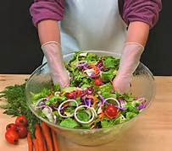
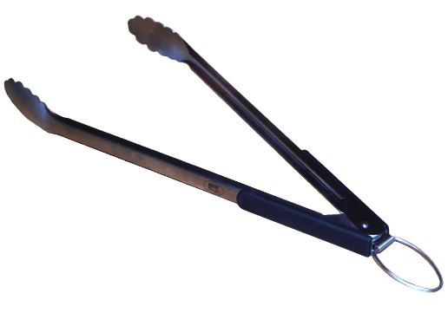
What should be used to handle ready-to-eat foods?
Risk Factor 4: Poor Employee Health & Hygiene
To prevent contamination, always use a barrier instead of bare hands when handling ready-to-eat foods
Barriers include:
Tongs
Deli paper
Single-use gloves

Slide 77
If you choose gloves, always follow these steps:
Risk Factor 4: Poor Employee Health & Hygiene
1
Wash your hands before putting on gloves.
2
Choose only single-use food service gloves.
3
Change gloves:
When they become damaged, dirty, or contaminated
When changing tasks
After handling dirty utensils or equipment
Between working with raw meat and ready to eat foods
4
After you have finished using a pair of gloves:
dispose of the gloves
and wash your hands
REMINDER:
To prevent cross-contamination, never wash or reuse single-use food service gloves.

Slide 78
Employee Illness
Risk Factor 4: Poor Employee Health & Hygiene
Sick food workers are a leading cause of foodborne illness outbreaks.
It is up to employees and managers to make sure that sick employees do not spread illnesses.

Slide 79
Employee Responsibilities
Risk Factor 4: Poor Employee Health & Hygiene
Employees are responsible for reporting certain symptoms and illnesses to the person in charge of the establishment
Symptoms employees must report to the person in charge are:
Diarrhea
Vomiting
Jaundice (yellowing of the eyes or skin)
Sore throat with fever
Infected lesion on hands or arms

Slide 80
Employee Responsibilities
Risk Factor 4: Poor Employee Health & Hygiene
Diagnosed illnesses employees must report to the person in charge are:
Salmonella
Shigella
E-coli
Hepatitis A
Norovirus

Slide 81
Manager Responsibilities
Risk Factor 4: Poor Employee Health & Hygiene
The person in charge at the establishment has a responsibility to restrict or exclude employees with certain symptoms and diagnosed illnesses.
“Restricting” means to limit the activities of a food employee.
“Excluding” means to prevent a person from working as an employee in a food establishment or entering a food establishment as an employee.
This prevents a spread of disease that is transmissible through food.

Slide 82
Restricting/Excluding Sick Employees
Risk Factor 4: Poor Employee Health & Hygiene
The person in charge of the establishment must exclude employees while they have:
Diarrhea, or
Vomiting
Employees can return to work after they have been without symptoms for at least 24 hours, or provides written medical documentation from a medical provider stating the symptom(s) is from a non-infectious condition.

Slide 83
Restricting/Excluding Sick Employees
Risk Factor 4: Poor Employee Health & Hygiene
The person in charge of the establishment must restrict or exclude* employees while they have:
E. coli
Salmonella
Shigella
Hepatitis A
*Always refer to the Employee Health section of the Tennessee Food Service Establishment Rules when determining if restriction or exclusion is required.

Slide 84
Restricting/Excluding Sick Employees
Risk Factor 4: Poor Employee Health & Hygiene
The person in charge of the establishment must also notify the health department when an employee has been diagnosed with:
E. Coli
Salmonella
Shigella
Hepatitis A
Norovirus
Or when an employee is jaundiced

Slide 85
5 Major Foodborne Illness Risk Factors:

1. Improper Holding & Cooling

2. Inadequate Cooking

Contaminated Food, Utensils and Equipment

Poor Employee Health and Hygiene
Food from Unsafe Sources

Slide 86
Risk Factor 5: Food from Unsafe Sources

Slide 87
What is a safe source?
Risk Factor 5: Food from Unsafe Sources
A food source is considered safe if:
A regulatory agency has approved it
The source delivers food to your establishment under proper conditions
Proper procedures are followed for shellfish they sell to you

Slide 88
Approved Sources
Risk Factor 5: Food from Unsafe Sources
An approved source means that a regulatory agency has determined that where the food is produced, prepared, or processed meets the standards required by law.
Any food that will be sold or served to customers must come from an approved source.
Local produce vendors (farmer’s markets, etc.) are allowed.

Slide 89
Identifying unsafe food when it is delivered
Risk Factor 5: Food from Unsafe Sources
Inspecting food when it is delivered is another way to ensure the food you serve in your establishment is safe. Be sure to check for:
Spoilage
Opened, rusty or severely damaged packaged or canned foods
Dented cans
Proper temperatures — received frozen must be frozen, cold foods must be 41°F or below.
These are all signs of unsafe food and should not be accepted by your establishment

Slide 90
Special Procedures for Shellfish
Risk Factor 5: Food from Unsafe Sources
To be sure the shellfish (oysters, clams, mussels) your establishment serves is safe, verify the source is listed in the Interstate Certified Shellfish Shippers (ICSS) list, which can be located at www.fda.gov
Identification tags should be attached to the shellfish container
Your establishment must keep shellfish tags for 90 days.

Slide 91
Important Components of Shellfish Identification Tags
Risk Factor 5: Food from Unsafe Sources
Dealer name and address
Dealer certification number
Harvest date
Harvester certification number
Harvest location
Bold and capitalized statement that “This tag is required to be attached until container is empty and thereafter kept on file for 90 days.”
Type and quantity of shellfish

Slide 92
5 Major Foodborne Illness Risk Factors:

1. Improper Holding & Cooling

2. Inadequate Cooking

Contaminated Food, Utensils and Equipment

Poor Employee Health and Hygiene

Food from Unsafe Sources

Slide 93
Additional Prevention Measures in the 2009 Food Code

Slide 94
Adoption of the 2009 FDA Food Code
2009 Food Code
Effective July 1, 2015 the state of Tennessee implemented new rules governing food service establishments. These rules are based in part on the 2009 FDA Food Code.
Health inspections in Tennessee, as well as this training, are based on the rules of TN Food Service Establishment Rules.

Slide 95
What’s in the new code?
2009 Food Code
The changes under the new TN Food Service Establishment Rules include requirements for:
Consumer advisory
Date marking
Specialized processing
Parasite destruction
Manager certification/demonstration of knowledge

Slide 96
TN Food Service Establishment Rules: Consumer Advisory

Slide 97
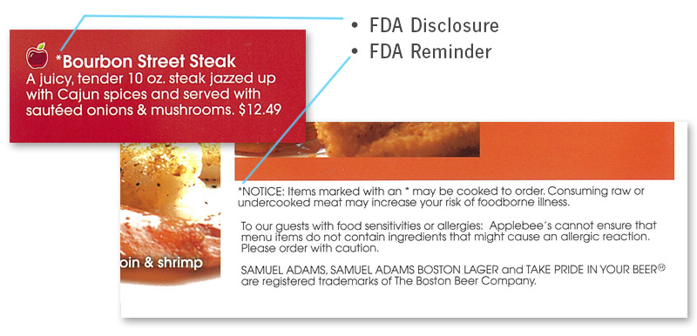
Have you seen notes like these before?
TN Food Service Establishment Rules: Consumer Advisory
They’re an example of a consumer advisory.

Slide 98
What is a consumer advisory?
TN Food Service Establishment Rules: Consumer Advisory
A consumer advisory is a way to let customers know:
Which menu items that contain animal foods that are:
Raw,*
Undercooked*, or
Without otherwise being processed to eliminate pathogens*
The increased risk of foodborne illness associated with consuming those items
*Consumer advisories are required for these kinds of foods.

Slide 99
What does a consumer advisory look like?
TN Food Service Establishment Rules: Consumer Advisory
Disclosure
Reminder
There are two sections that must be included in a consumer advisory.

Slide 100
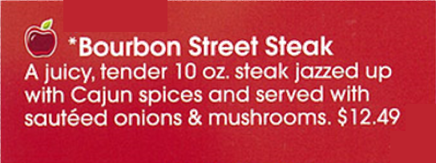
What is the disclosure in a consumer advisory?
TN Food Service Establishment Rules: Consumer Advisory
The disclosure in a consumer advisory:
Is a written statement, and
Clearly identifies items with animal foods that are, or can be ordered, raw or undercooked

Slide 101
What is the disclosure in a consumer advisory?
TN Food Service Establishment Rules: Consumer Advisory
Disclosures must include two parts:
2
1
A description of the food
Identification of the foods by asterisking (*) to a footnote stating the items are served raw or undercooked

Slide 102
What is the reminder in a consumer advisory?
TN Food Service Establishment Rules: Consumer Advisory
The reminder in a consumer advisory:
Is a written statement, and
Is asterisked to make it clear to the customer which foods the reminder applies to, and
Includes specific wording about the health risk of consuming raw or undercooked animal foods

Slide 103
What is the reminder in a consumer advisory?
TN Food Service Establishment Rules: Consumer Advisory
The wording in the reminder must be:
“Consuming raw or undercooked meats, poultry, seafood, shellfish or eggs may increase your risk of foodborne illness.” or
“Consuming raw or undercooked meats, poultry, seafood, shellfish or eggs may increase your risk of foodborne illness, especially if you have certain medical conditions.” or
“Regarding the safety of these items, written information is available upon request.”

Slide 104
Where should a consumer advisory be?
TN Food Service Establishment Rules: Consumer Advisory
A consumer advisory can be included on:
Reminder statements on the menu or deli case
Placards
Table tents
Brochures or pamphlets
Other areas where it can be written and clearly seen by customers

Slide 105
Which of these foods require a consumer advisory? (click an option below)
Test Your Knowledge
*
Milk
Poultry
Lamb
Fish
Eggs
Pork
Beef
Shellfish
Any animal food that will be served or sold raw, undercooked, or without otherwise being processed to eliminate pathogens must have a consumer advisory.

Slide 106
TN Food Service Establishment Rules: Date Marking

Slide 107
What is date marking?
TN Food Service Establishment Rules: Date Marking
Even foods that are refrigerated can grow bacteria that can cause foodborne illness.
Date marking is a way to identify how old foods are, and when those foods should be discarded to prevent bacteria from causing foodborne illness.

Slide 108
What foods need to be date marked?
TN Food Service Establishment Rules: Date Marking
Foods require date marking when they are:
Prepared in house OR commercially,
Refrigerated,
Ready-to-eat,
Held for longer than 24 hours, and
A TCS food.

Slide 109
What foods need to be date marked?
TN Food Service Establishment Rules: Date Marking
REMEMBER! TCS foods include:
Meat, fish, poultry, seafood
Eggs & dairy products
Cooked vegetables
Tofu
Cooked rice, beans, pasta and potatoes
Sprouts (alfalfa and bean)
Cut melons
Garlic or herbs bottled in oil
Sliced tomatoes & cut leafy greens
Foods require date marking when they are:
Prepared in house OR commercially,
Refrigerated,
Ready-to-eat,
Held for longer than 24 hours, and
A TCS food.

Slide 110
Are there exceptions to date marking?
TN Food Service Establishment Rules: Date Marking
Date marking is not required for the following items:
Deli salads
Aged hard cheese
Semi-soft cheeses
Cultured dairy products
Preserved Fish products
Shelf stable dry fermented sausages
Shelf stable salt-cured products

Slide 111
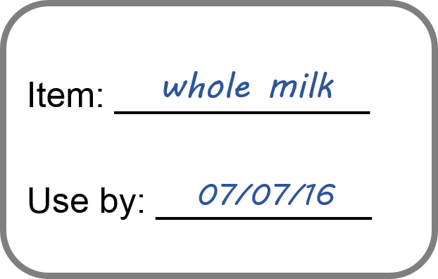
What should a date mark include?
TN Food Service Establishment Rules: Date Marking
A day or date should be clearly written on the food package to indicate when the food should be consumed, sold, or discarded
Other dates may also be listed, but they are not required
The day/date written can be no more than seven (7) days from when the food was prepared (if prepared in house) or opened (if it was commercially prepared)
This item was opened on 7/01/16
Note: If food is not properly dated, it must be used or discarded within 24 hours.

Slide 112
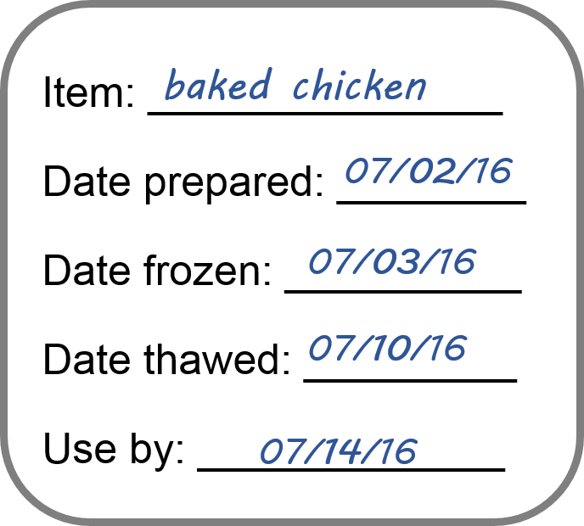
Does freezing a food change its date mark?
TN Food Service Establishment Rules: Date Marking
Freezing a food stops the date marking clock, but does not reset it
When a food requiring date marking is frozen, the marking must include:
Use by date,
Freezing date,
Thawing date, and
Preparation date
This makes it clear how many of the original seven days have been used.

Slide 113
Example: Freezing & Date Marking
TN Food Service Establishment Rules: Date Marking
1
The food is prepared and date marked, and is counted as the first of 7 days it is safe to use.

Slide 114
Example: Freezing & Date Marking
TN Food Service Establishment Rules: Date Marking
2
1
The food is stored at 41º F for two days.
The food is prepared and date marked, and is counted as the first of 7 days it is safe to use.

Slide 115
Example: Freezing & Date Marking
TN Food Service Establishment Rules: Date Marking
2
3
1
The food is stored at 41º F for two days.
The food is frozen at 0º F the next day, and since it was not frozen all day, it counts as one of the 7 days.
The food is prepared and date marked, and is counted as the first of 7 days it is safe to use.

Slide 116
Example: Freezing & Date Marking
TN Food Service Establishment Rules: Date Marking
2
3
1
The food is stored at 41º F for two days.
The food is frozen at 0º F the next day, and since it was not frozen all day, it counts as one of the 7 days.
The food is prepared and date marked, and is counted as the first of 7 days it is safe to use.
4
The food remains frozen for 3 days.

Slide 117
Example: Freezing & Date Marking
TN Food Service Establishment Rules: Date Marking
2
3
1
The food is stored at 41º F for two days.
The food is frozen at 0º F the next day, and since it was not frozen all day, it counts as one of the 7 days.
The food is prepared and date marked, and is counted as the first of 7 days it is safe to use.
4
The food remains frozen for 3 days.
5
The food is thawed and stored at 41º F. This counts as one of the 7 days because it is above 0º F for part of the day.

Slide 118
Example: Freezing & Date Marking
TN Food Service Establishment Rules Date Marking
2
3
1
The food is stored at 41º F for two days.
The food is frozen at 0º F the next day, and since it was not frozen all day, it counts as one of the 7 days.
The food is prepared and date marked, and is counted as the first of 7 days it is safe to use.
4
The food remains frozen for 3 days.
5
6
The food is thawed and stored at 41º F. This counts as one of the 7 days because it is above 0º F for part of the day.
The food is stored at 41º F and discarded at the end of the day.

Slide 119
How does combining foods affect date marking?
TN Food Service Establishment Rules: Date Marking
If different containers of foods are combined, the date of the oldest ingredient becomes the date marked on the package
For example: If today is Wednesday, and you are mixing salad prepared on Monday with salad prepared on Tuesday, the salad would be labeled as prepared on Monday.

Slide 120
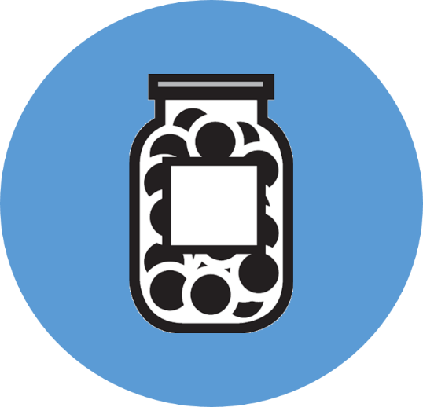
TN Food Service Establishment Rules: Specialized Processing

Slide 121
What is specialized processing?
TN Food Service Establishment Rules: Specialized Processing
Some establishments use food additives for preservation or prepare foods in ways that alter the atmosphere in a food package
To ensure these foods remain safe, a Food Safety Plan (or variance) is required if these types of practices will be used in your establishment

Slide 122
What is specialized processing?
TN Food Service Establishment Rules: Specialized Processing
Some specialized processing methods that require a Food Safety Plan (or variance) are:
Smoking for preservation
Curing food
Using food additives, such as vinegar for preservation
Reduced oxygen packaging
Operating a molluscan shellfish life-support system display tank
Sprouting seeds or beans

Slide 123
TN Food Service Establishment Rules: Parasite Destruction

Slide 124
When is parasite destruction needed?
TN Food Service Establishment Rules: Parasite Destruction
Some species of fish contain parasites that can be harmful when eaten.
Parasites are killed during normal cooking, but become a concern when fish are eaten in dishes such as sushi, sashimi, and ceviche, when the fish is :
Raw,
Undercooked, or
Lightly preserved.
Freezing to specified temperatures can kill parasites, allowing these foods to be safe to eat.

Slide 125
How can parasites be destroyed by freezing?
TN Food Service Establishment Rules: Parasite Destruction
To ensure raw or partially cooked fish is safe to eat, it must be:
Frozen at -4°F or below for at least seven days, or
Frozen at -31°F or below until solid and stored at -31° or below for a minimum of 15 hours, or
Frozen at -31°F or below until solid and stored at -4°F or below for a minimum of 24 hours

Slide 126
Are there exemptions for parasite destruction?
TN Food Service Establishment Rules: Parasite Destruction
Some species are exempt from this requirement, including:
Molluscan shellfish
Tuna of the species allalunga, albacares (Yellowfin), atlanticus, maccoyii (Bluefin, southern), obesus (Bigeye), or thynnus (Bluefin, northern)
Aquacultured fish, such as salmon if:
Raised in net-pens in open water, or
Raised in land-based ponds or tanks, and
Are fed formula feed that contains no live parasites infective to the aquacultured fish
Fish eggs that have been removed from the skein and rinsed

Slide 127
TN Food Service Establishment Rules: Manager Certification

Slide 128
What is required of a manager?
TN Food Service Establishment Rules: Manager Certification/Demonstration of Knowledge
An establishment should always have a designated “person in charge” (PIC) at the establishment.
The PIC is required to have demonstrate appropriate food safety knowledge.
This knowledge can be demonstrated by:
ANSI-approved food safety certification of one employee,
Having an inspection with no priority item violations, or
Correctly answering food safety questions at the time of inspection.

Slide 129
What if a manager chooses certification?
TN Food Service Establishment Rules: Manager Certification/Demonstration of Knowledge
If a manager choose to obtain a certification, it must be from a program using the Conference for Food Protection Standards
You can find a qualified program at the American National Standards Institute’s website, which has a listing of accredited personnel certification programs utilizing the Conference for Food Protection Standards:
https://www.ansica.org/wwwversion2/outside/ALLdirectory Listing.asp?menuID=8&prgID=8&status=

Slide 130
What if a manager chooses demonstration of knowledge?
TN Food Service Establishment Rules: Manager Certification/Demonstration of Knowledge
If a manager chooses demonstration of knowledge, they must be prepared to*:
Describe the relationship between personal hygiene of a food employee and the prevention of foodborne illness.
Explain the responsibilities, rights, and authorities assigned to the food employees and person in charge.
Explain proper procedures for sanitizing utensils and food contact surfaces of equipment.
Correctly answer additional questions about food safety procedures.
*Manager can be aided by utilizing TN Department of Health Demonstration of Knowledge Fact Sheet or other food safety materials.

Slide 131
Congratulations! You have completed this training!
Next, take the Knox County HD Food Safety Awareness Test
This test asks about food safety practices that you learned in the KCHD Food Safety Training. You will earn a certificate of completion for the training if you receive a score of 70% or higher. Results can take up to 2 weeks to process.
Click here to take the test.
For additional food safety information and handouts visit our website:
http://www.knoxcounty.org/health/food_protection.php
If you have any issues or questions, please call 865-215-5200

